Slide 1
Software Developer Internship
Fred O’hara
Fall 2016
Madison College

Slide 2
Trident Contract Management
Salesforce Programming
Solutions Provider
Diverse Code Base
Refactoring
Test Coverage

Slide 3
Key Accomplishments
New Languages
Apex
API Manipulation
SOAP
SOQL
Visualforce
REST
Dynamic Search Redesign
AngularJS POC
JQuery plugin POC
UI improvements
Performance Improvements

Slide 4
Work Team Structure
Temple Sutfin – VP Development
Project Mgr.
Project Mgr.
Project Mgr.
Sr. Developer
Developer
Intern
Sr. Developer
Developer
Intern
Sr. Developer
Developer
Intern

Slide 5

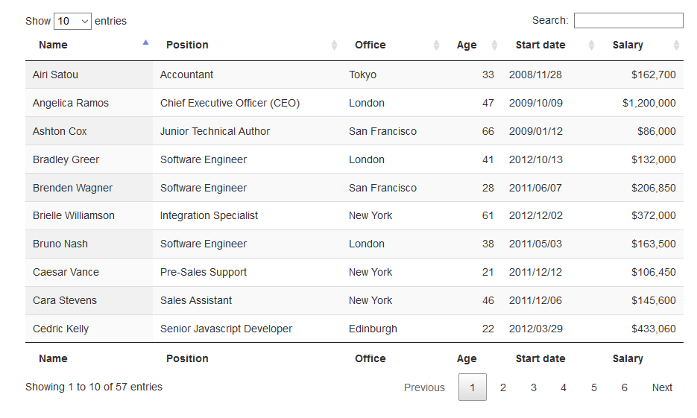
Data Table Example

Slide 6
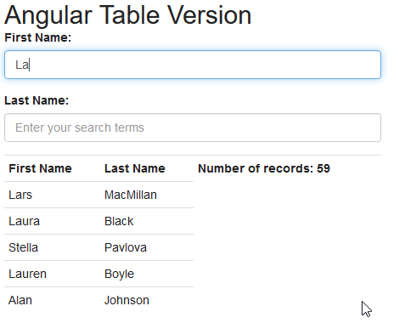
Angular Dynamic Search POC

Slide 7
Tools
Front-End
Back-End
HTML
CSS
JavaScript
VisaulForce
Jquery
Data Tables Plugin
AngularJS
Salesforce Ajax Toolkit (REST API)
Apex
SOQL
Triggers
Bootstrap
Unit Testing
JSON
Applications
Salesforce Adminstration
Excel
Data Loader IO
Gearset Deployments
Github
Atom Text Editor
Maven’s Mate SFDC add-on

